Slide 1
Analysis and Forecasting of Bank's Stock Price.
EDA PROJECT

Slide 2
AGENDA
INTRODUCTION
PROJECT OBJECTIVE
DATA AVAILABILITY
DATA OVERVIEW
DATA PREPARATION AND UNDERSTANDING
DATA ANALYSIS
PERFORMANCE INSIGHTS
KEY RECOMMENDATION

Slide 3
INTRODUCTION
The goal of this project is to analyze the historical stock price data of a bank and to forecast its stock price for the next six months. This analysis will include identifying trends, patterns, and key factors influencing the stock price over time.

Slide 4
PROJECT OBJECTIVE
The primary objective of this project is to perform a comprehensive analysis of historical stock price data from July 2005 to November 2020. The goal is to identify significant trends, growth periods, decline periods, and overall performance of the stock. This analysis aims to provide insights that can aid in understanding the stock's historical behavior, volatility, and potential investment opportunities.

Slide 5
Data Availability
The data set we will be using for this project is
YesBank_StockPrices

Slide 6
Data Overview
The dataset contains monthly stock price information for a bank from July 2005 to November 2020. The data includes the following fields:
* Date: Month and year of the recorded stock price.
* Open: Opening price of the stock for the month.
* High: Highest price of the stock for the month.
* Low: Lowest price of the stock for the month.
* Close: Closing price of the stock for the month.

Slide 7
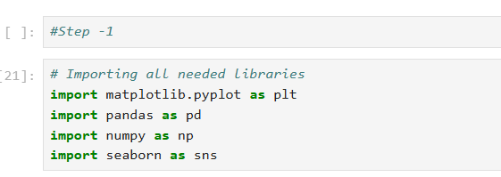
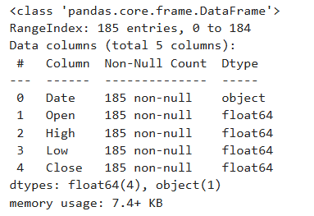
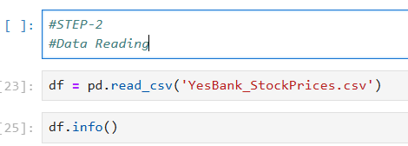
DATA PREPARATION AND UNDERSTANDING
Output:

Slide 8
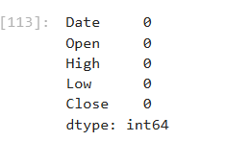

DATA PREPARATION AND UNDERSTANDING
output

Slide 9
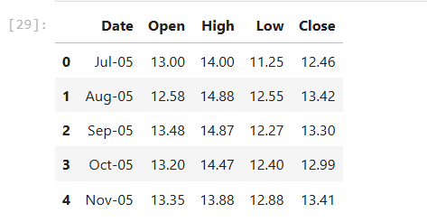
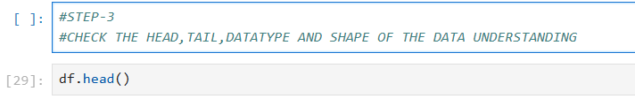
DATA PREPARATION AND UNDERSTANDING
Output:-

Slide 10
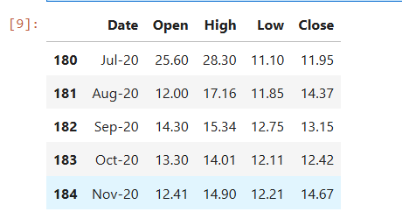

DATA PREPARATION AND UNDERSTANDING
Output:-

Slide 11
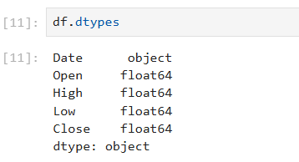
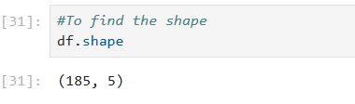
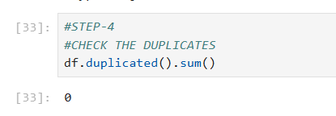
DATA PREPARATION AND UNDERSTANDING

Slide 12
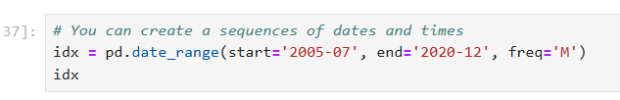
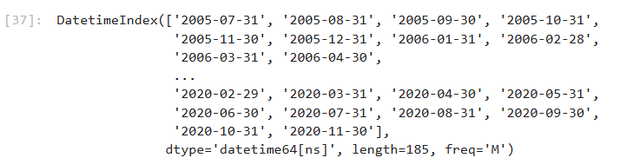
DATA ANALYSIS
Output:-

Slide 13
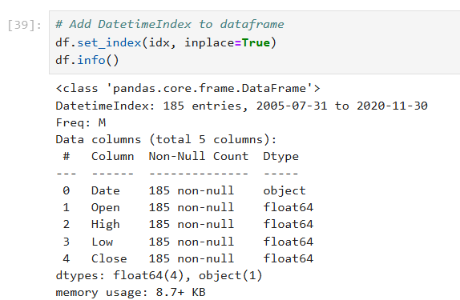
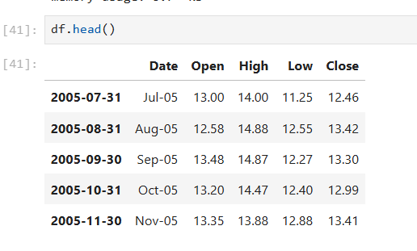
DATA ANALYSIS

Slide 14
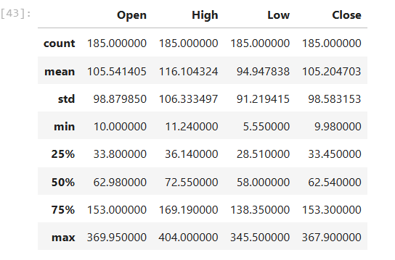

DATA ANALYSIS

Slide 15
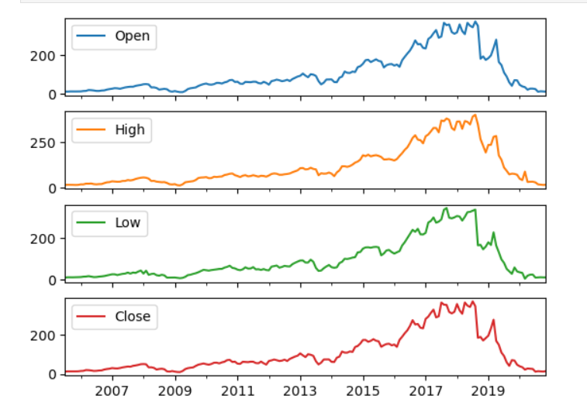
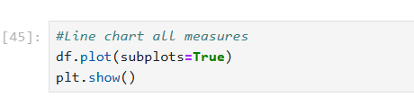
DATA ANALYSIS

Slide 16
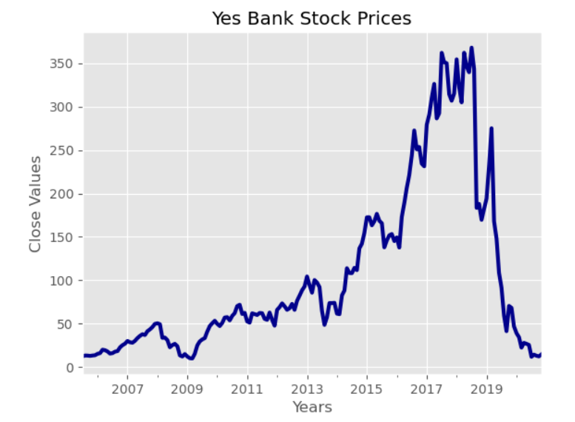
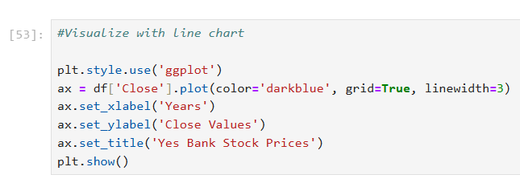
DATA ANALYSIS
Output

Slide 17
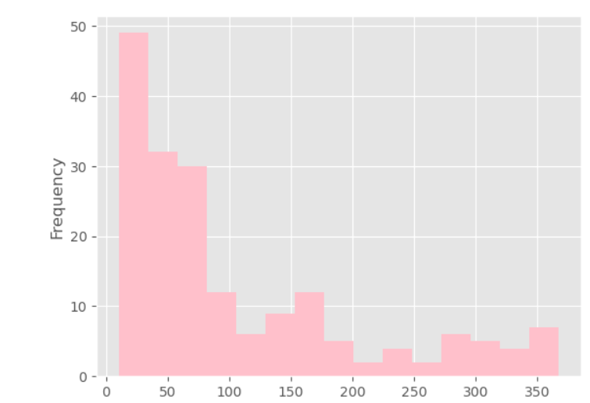
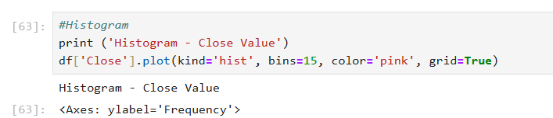
DATA ANALYSIS
Output:-

Slide 18
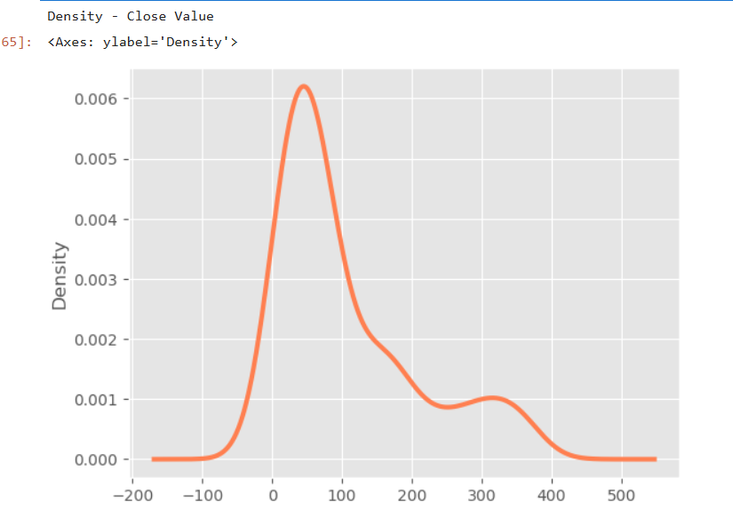

DATA ANALYSIS
Output:-

Slide 19
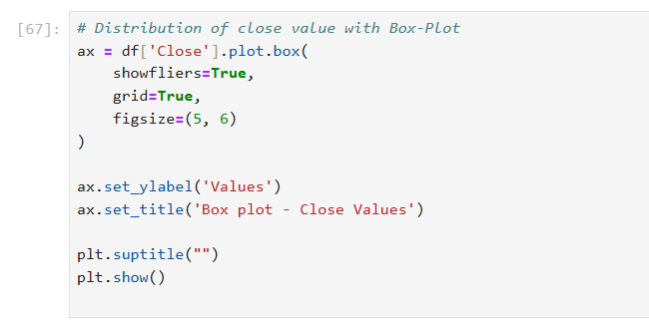
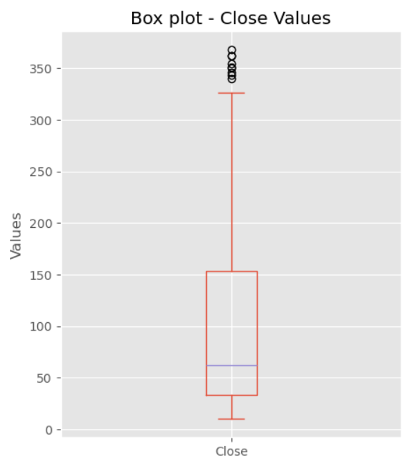
DATA ANALYSIS
Output:-

Slide 20
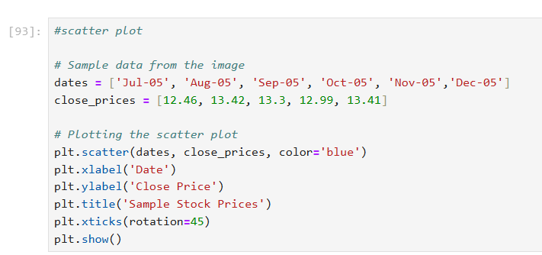
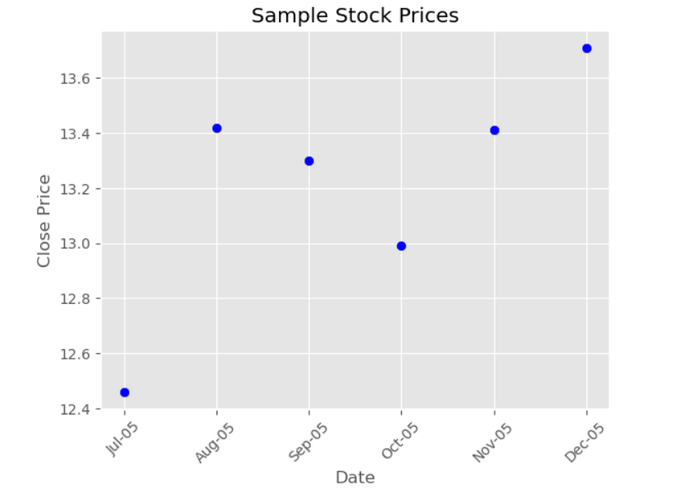
DATA ANALYSIS
Output:-

Slide 21
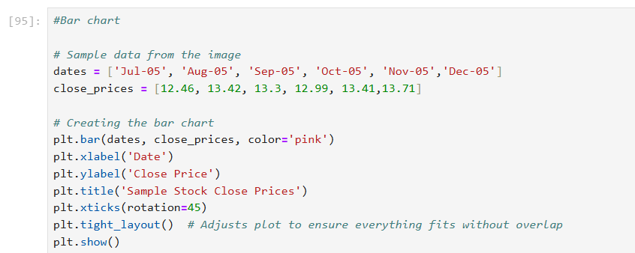
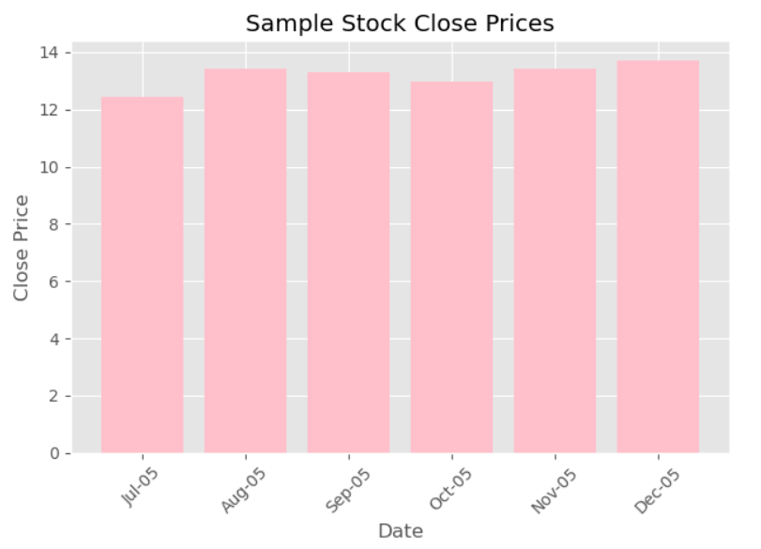
DATA ANALYSIS
Output:-

Slide 22
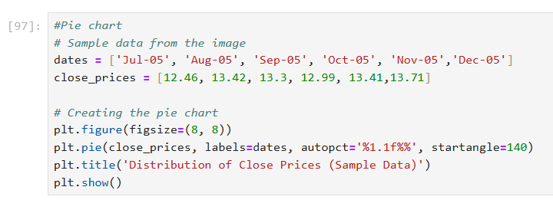
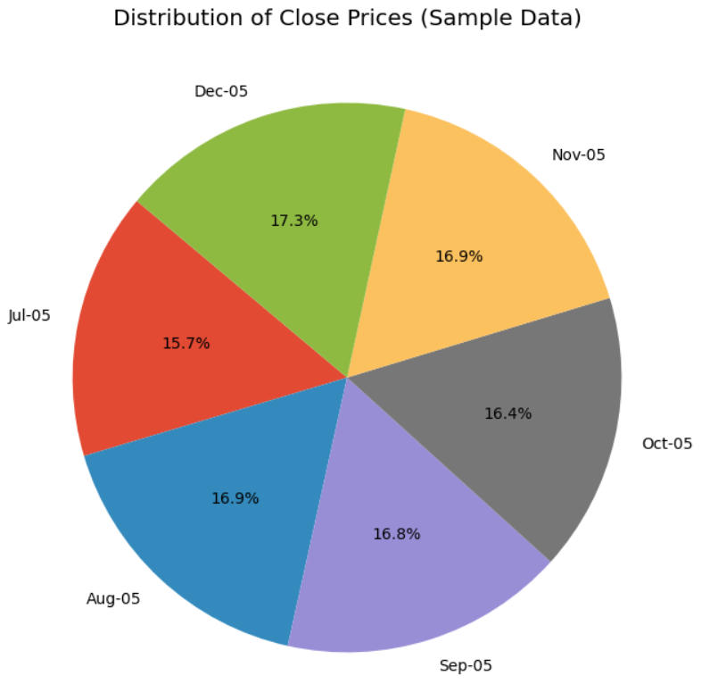
DATA ANALYSIS
Output:-

Slide 23
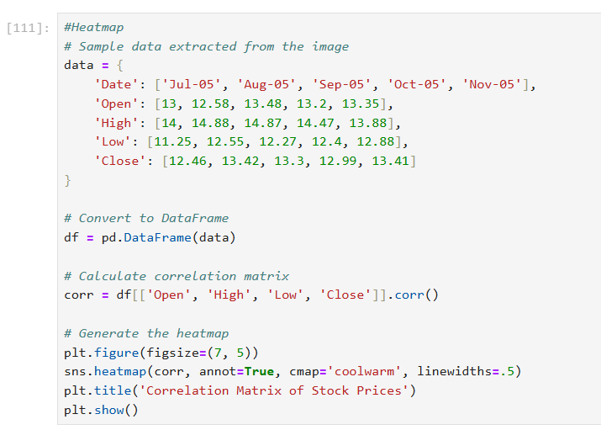
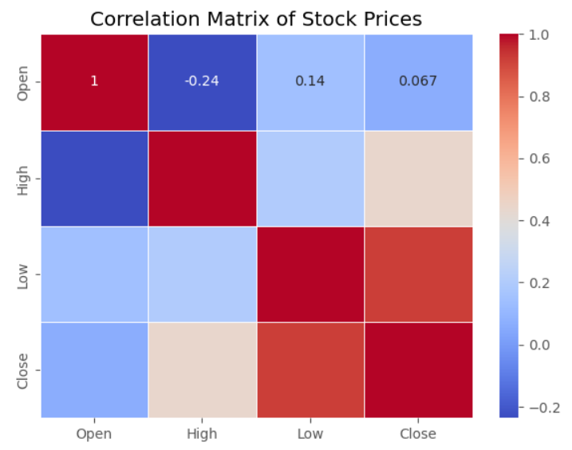
DATA ANALYSIS
Output:-

Slide 24
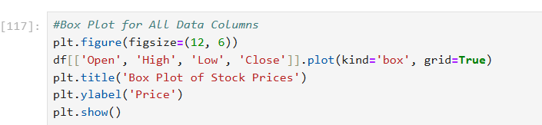
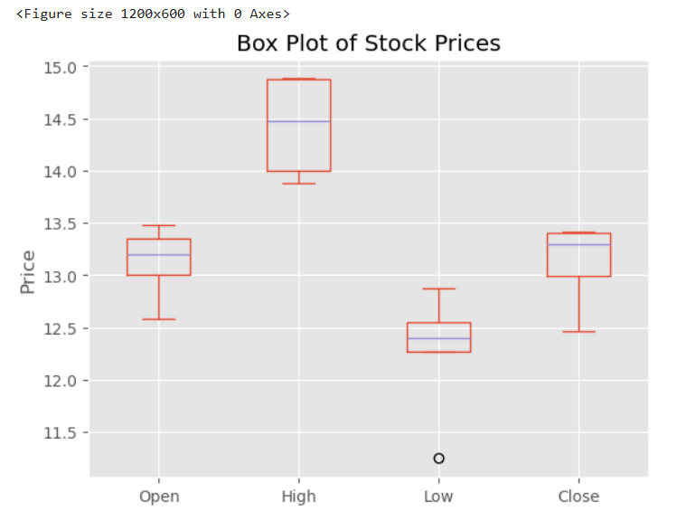
DATA ANALYSIS
Output:-

Slide 25
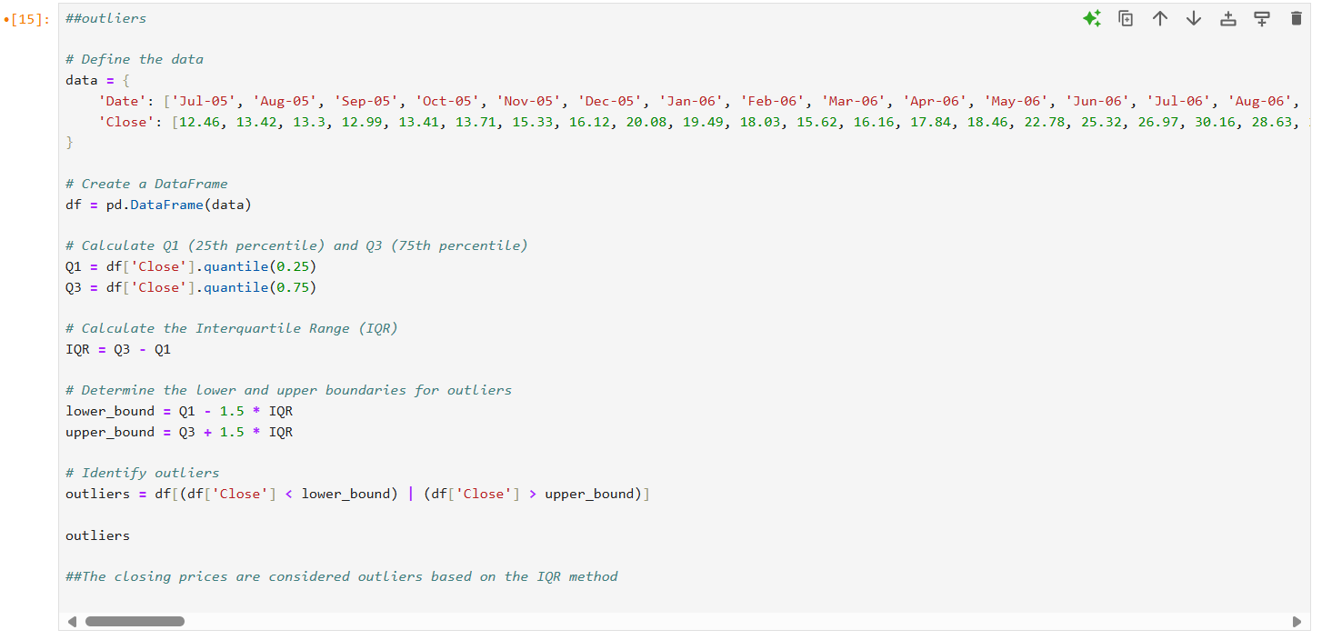
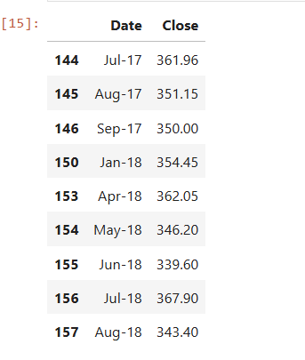
DATA ANALYSIS
Output:-

Slide 26
PERFORMANCE INSIGHTS
Summary:--
- Initial Phase (2005-2008):- The stock showed moderate growth initially, followed by a step decline during the 2008 financial crisis.
- Recovery and Growth (2009-2014):- Post-2008, the stock rebounded strongly, showing consistent growth till 2014.
- Peak and Volatility (2015-2017):- The stock reached new peaks but experienced high volatility.
- Recent Trends (2018-2020):-The stock saw significant fluctuations with sharp drops in 2018 and 2020 but managed to recover partially.
### Monthly Data Analysis
- Best Month:- Jan-15, with a high of $179.00 and a closing of $172.50.
- Worst Month:-Mar-20, with a high of $87.95 and a closing of $22.45.

Slide 27
PERFORMANCE INSIGHTS
### Final Observations
- The stock has demonstrated resilience with periods of recovery following sharp declines.
- The overall long-term trend is positive despite significant volatility.
- Investors should be cautious of high volatility periods and significant external impacts such as economic crises and global events like the COVID-19 pandemic.
### Conclusion
The stock has shown potential for high returns over the long term but comes with considerable risks due to its volatility. Investors should consider these factors when making investment decisions.

Slide 28
KEY RECOMMENDATIONS
1. Perform Comprehensive Data Analysis:
Conduct exploratory data analysis (EDA) to understand the overall trends, patterns, and anomalies in the data.
Visualize the data using line charts, histograms, and box plots to gain insights into stock performance over time.
2. Identify and Handle Outliers:
Use the IQR method or other statistical techniques to identify outliers in the stock prices.
Decide on an appropriate method to handle outliers (e.g., removing them, transforming them, or using robust statistical methods that are less sensitive to outliers).
3. Analyze Seasonality and Trends:
Decompose the time series data to analyze the seasonal patterns and long-term trends.
Use techniques like moving averages or exponential smoothing to identify trends.
4. Forecast Future Prices:
Implement time series forecasting models such as ARIMA, SARIMA, or machine learning models like LSTM to predict future stock prices.
Evaluate the performance of different models using metrics like Mean Absolute Error (MAE) or Root Mean Squared Error (RMSE).

Slide 29
Thank you………
Surya K
Mail :- suryakarolly@gmail.com

